Slide 1
Bartók’s Polymodality
The Dasian and Other Affinity Spaces
José Oliveira Martins

Slide 2
Combination of distinct diatonic layers
Analytical activity developed for this repertoire downplays scalar integrity of combined diatonic materials.
Tonal approaches reduce the chromaticism of combined strata into deeper-level diatonicism
Atonal approaches scatter surface diatonicism into deeper-level chromaticism.
Which resources and properties of the pitch system are explored by the interaction of layered diatonic materials, and how are such interactions best interpreted in light of local and global harmonic relations?

Slide 3
Bartók’s polymodal chromaticism
Bartók superimposes a Lydian and Phrygian pentachord with a common fundamental tone to get a diatonic pentachord filled out with all the possible flat and sharp degrees.
Bartók’s musical illustration of “polymodal chromaticism”

Slide 4
Bartók’s polymodal chromaticism
But these chromatic degrees are totally different in their function from altered chord degrees: they are diatonic ingredients of a diatonic modal scale.
Polymodal chromaticism reconciles that
(1) the global chromatic space combines diatonically coherent strata
(2) an underlying harmonic principle (“a common fundamental tone”) coordinates the strata.

Slide 5
A cyclic model
The Dasian space generalizes some aspects of the medieval Dasian scale:
affinity relations at the P5 of the four modal qualities that a given note can assume in any diatonic collection;
the group-theoretical properties that result from the coordination (order pairs) of pcs and modal qualities.
Affinity spaces generalize some of the group-theoretical properties that model relations between nondiatonic scalar materials

Slide 6
The Dasian space
Four TST (tone–semitone–tone) tetrachords, separated by tone of disjunction, plus two “residual” notes.
Each tetrachord embeds the four modal qualities—protus, deuterus, tritus, and tetrardus—defined by relative position of a note with respect to the interval pattern of the tetrachord.
The scalar arrangement of the Dasian scale privileges affinity relations at the P5, as opposed to octave

Slide 7
The Dasian space is closed
an ordered cycle of 48 space elements;
each pc appears 4 times at different modal quality (mq) positions,
each modal quality appears 12 times at different pc equivalences
The four medieval modal qualities are relabeled as cyclic order positions
protus = mq(2), deuterus = mq(3), tritus = mq(0), and tetrardus = mq(1).
The ordering 〈mq(0), mq(1), mq(2), mq(3)〉 privileges the continuity of WT scalar adjacencies, where radii in the figure mark off the semitone between neighboring positions mq(3) and mq(0).
Each space element is uniquely defined as an ordered pair coordinating a pc x and a modal quality y: [pc(x), mq(y)], where 0 ≤ x ≤ 11 and 0 ≤ y ≤ 3.

Slide 8
The Dasian space is closed
the space exhausts several larger diatonic structures related by P5 (12x):
semitones (unique scale-step locations in the space),
“Dorian” tetrachords (TST),
guidonian hexachords (TTSTT), and
locally diatonic octave-fifth regions.
The Dasian stands both as a scalar space (where the order of modal qualities interacts with register) and a pc space (where each element assumes octave and enharmonic equivalence).

Slide 10
Reframed within Bartók’s illustration of polymodal chromaticism: C and G represent 6 overlapping diatonic regions
Distance measured in terms of chromatic mismatch rather than between pitch centers

Slide 11
Each modal quality affinity relation structured by one of 5 interlocked circles of 5ths
The motion of 4 steps retains modal quality and induces change of pc
Solid transformatio arrows track the motion f, (C, 3) → (C, 2) → (C, 1) → (C, 0)
Dotted f arrow from (C, 0) to (C♯, 3), enacts a change of pc by T1 (mod 12), continuing the descent in modal-quality order position from mq(0) to mq(3)

Slide 12
Two types of outcomes for a transformatio move
a pc retention when the move is applied to mq(3), mq(2), or mq(1),
a pc change (by T1, mod 12) when applied to mq(0).
either s effects an “ascending whole-tone” (T2, mod 12) when applied to mq(0), mq(1), and mq(2), or s effects an “ascending semitone” (T1, mod 12) when applied to mq(3)
A complete 48-transformatio cycle results from the succession of twelve complete four-modal-quality cycles of descending order position (each 4-mq cycle goes through 4 pc occurrences).
the complete cycle isomorphic with the structure of the complete (clockwise) 48-step cycle

Slide 13
Bartók’s octatonic “Diminished Fifth” (Mikrokosmos no. 101)
mm. 1–11, A A′ | mm. 12–25, B A′ | mm. 26–44, B′ A
superimposes“Dorian” (0235) tetrachords related by T6
A OCT 2,3 B OCT 0,1 –> OCT 2,3 A’ OCT 1,2 –> OCT 0,1 –> OCT 2,3
Two views: global octatonic macroharmony or a linear modal partition
B to A′ yields E♭-Dorian, A-Dorian
3rd section: B′ moves by T7 toB♭-Dorian, E-Dorian

Slide 14
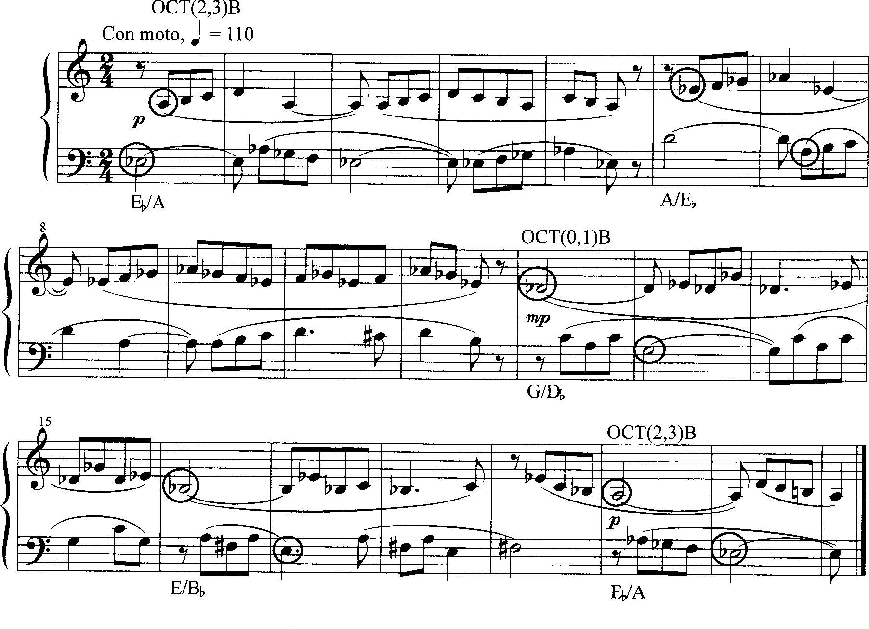
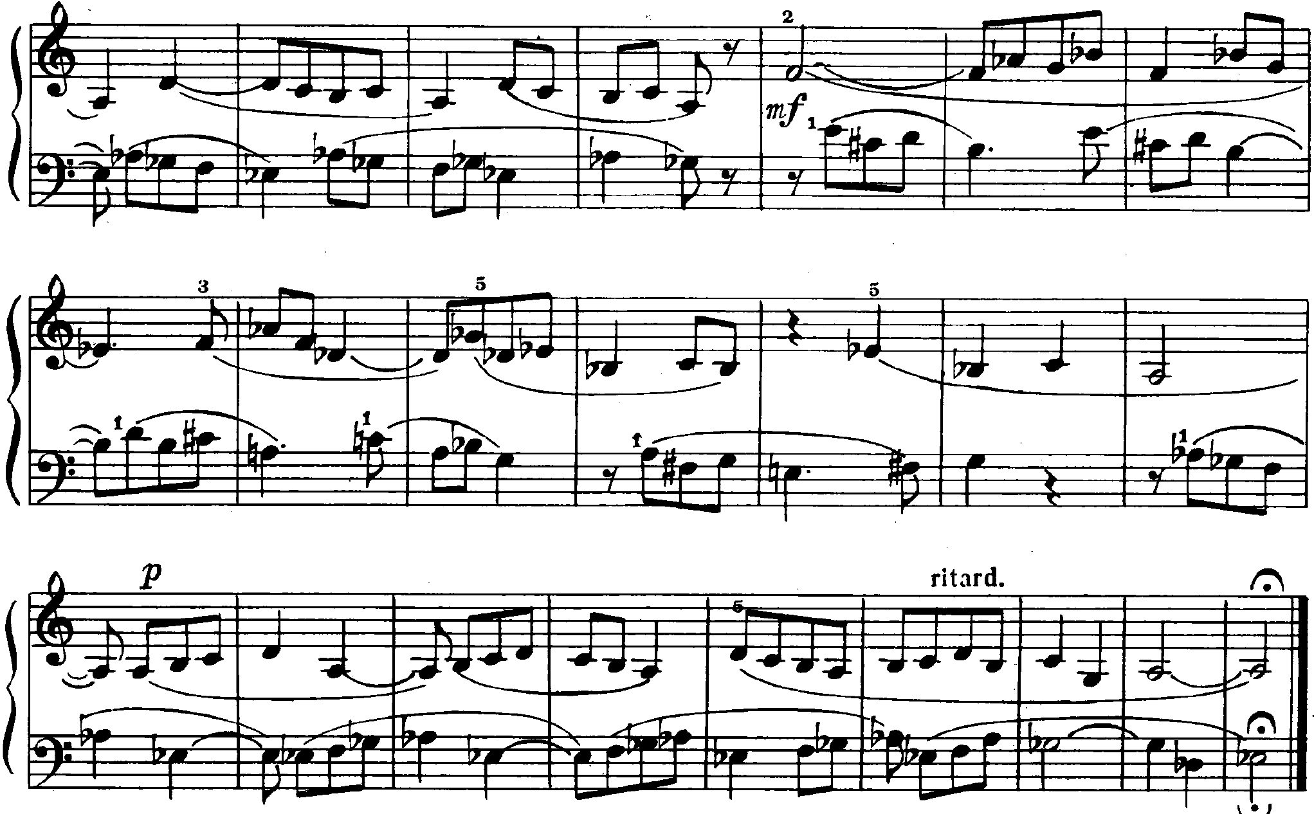
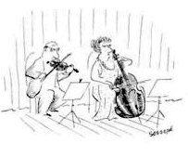

Slide 17
“Melody against Double Notes” (Mikrokosmos no. 70)
Up to m. 16, both hands present (0257) tetrachords, suggesting Al (left hand), D–E–G–A, and Ar (right hand), F♯–G♯–B–C♯.
In mm. 1–9, rh emphasizes F♯, lh plays accompaniment chords
mm. 10–16 reverses tetrachordal roles: lh inverted melody emphasizes A and a rh accompaniment.
After m. 17, gapped tetrachordal segments filled by F and A♯, respectively, resulting in inversionally related (02357) pentachords D–E–F–G–A and F♯–G♯–A♯–B–C♯.

Slide 18
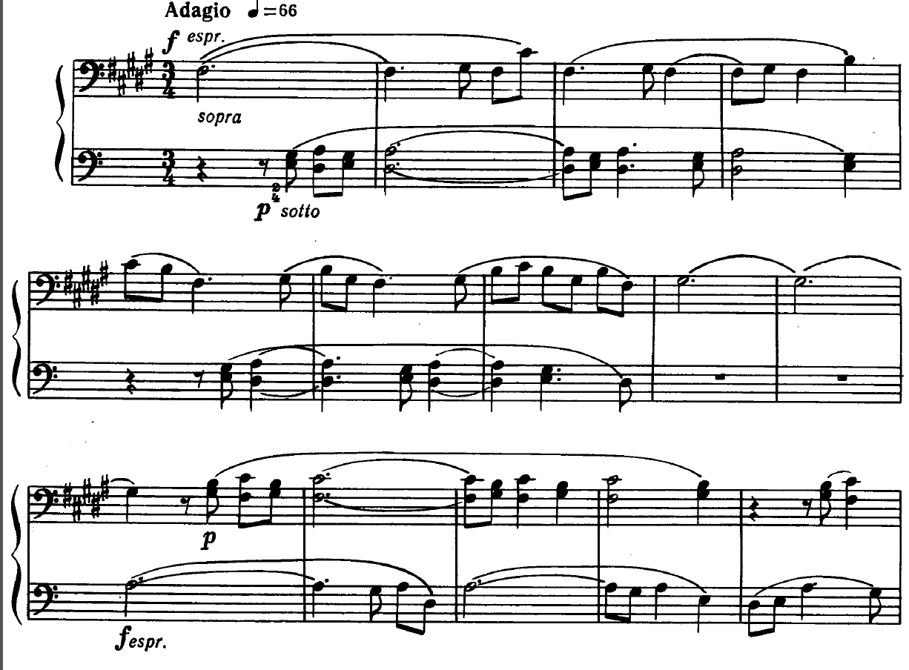
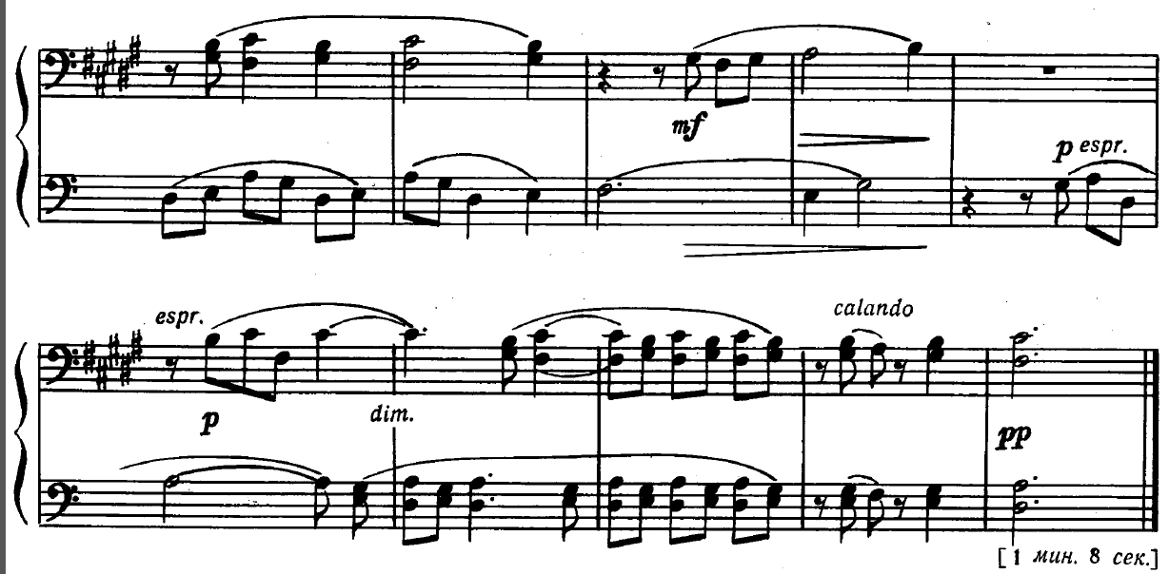
A
A
B

Slide 19
6 8 [T] E 1
6 8 [9] E 1
2 4 [6] 7 9
2 4 [5] 7 9

Slide 20
Lack of a defining semitone means two possible locations in Dasian space:
A and B “Major” pentachord D–E–F♯–G–A;
lh A inverted melody (mm. 10–16) suggests “minor” segment F♯–G♯–A–B–C♯.
F♯ and A “major and minor third imprints” = f and f–1
Counterclockwise dotted change of mq, from Ar to Al for F♯, that is, f −1, (F♯, 2) → (F♯, 3)
Clockwise transformatio (dotted arrow) signals reinterpretation Al to Ar for A, that is, f, (A, 1) → (A, 0)

Slide 21
The segments at A more closely located in Dasian space, given their minimal step mismatch created by (G, 0) and (G♯, 3).
Segments symmetrically located in space around C♯/D and G/G♯, reflecting symmetry created by combination of tetrachords in pitch space.
Arrival of F and A♯ (m. 17) integral to each (located at [F, 0] and [A♯, 3], respectively)
a symmetrical shift to locations at B, via f and f −1 (solid arrows).
mismatch between (F/F♯, G/G♯, A/A♯) reflected in increased harmonic distance of segments in the space
inversional relation between pentachords reflected in both Dasian and pitch space.

Slide 22
Polymodality in Bartók’s Piano Sonata, iii
Rotation = reiteration of cyclic sequence of blocks, which include time units, from whole sections to brief passages, whose thematic materials, or prominent textural changes, result in significant formal markers
A thematic refrain pentatonic F♯ 〈−2, −3, −2, −2〉
Episodic themes feature transposed pentatonic variants of the refrain
Main thematic statements (blocks A, E, and G) provide higher formal stability; remaining passages (blocks B, C, D, and F) project transitional, dynamic, and closing formal functions

Slide 23
Three analytic claims about Piano Sonata, iii
Polymodal combinations and textures modeled by Dasian space
Tonal patterns reinforce internal relationships between blocks
Pitch exploration in first three blocks creates larger continuous unit
The specific Dasian regions explored depend on the distribution of semitones that “fill in” each pentatonic framework.
Polymodal scope of fixed refrains expanded in later rotations
Relation between superimposed layers changes at every rotation
Dasian approach clarifies and reinforces the claim for a strong closure

Slide 24
Claim for strong closure
tentative closure is offered with insertion of a new episodic variant or theme (in block G) at the end of rotation 3
more emphatic and definitive closure offered through the dissolution of the refrain’s harmonic and thematic features in the contracted block C/D in rotation 4.
The alteration of formal patterns at the end of the movement also provides a solution for the compositional problem posed by a cyclic form: how to articulate a closure without leading into a new rotation.

Slide 25
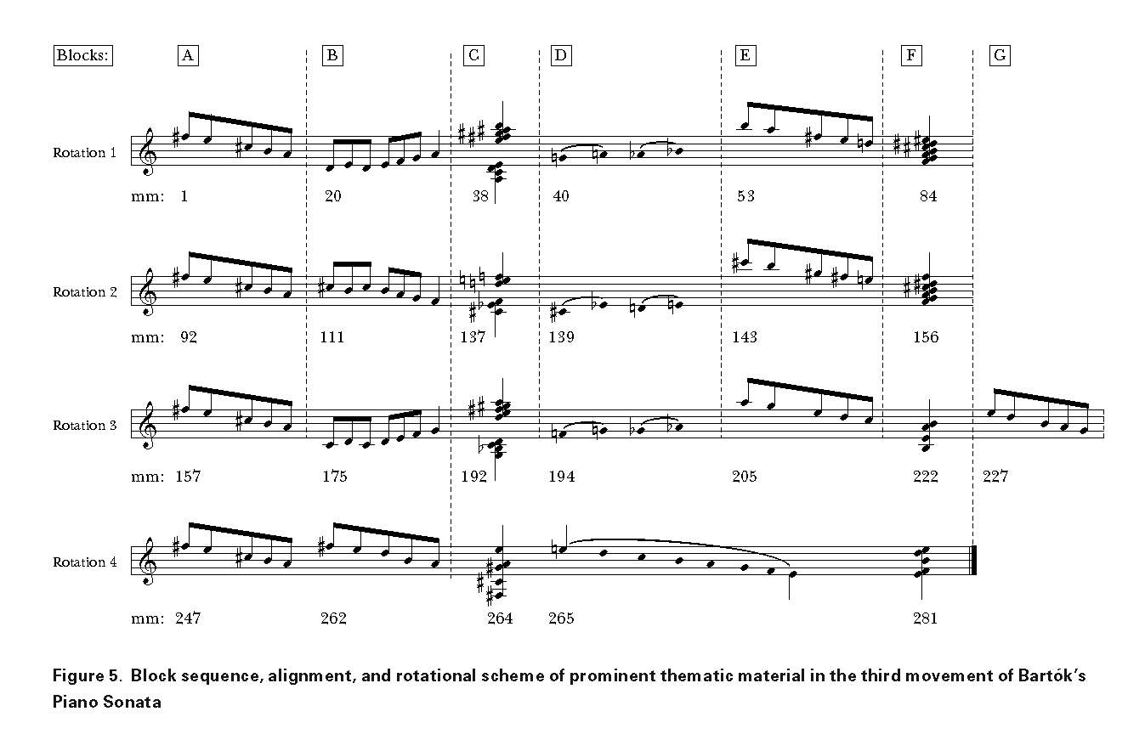

Slide 26
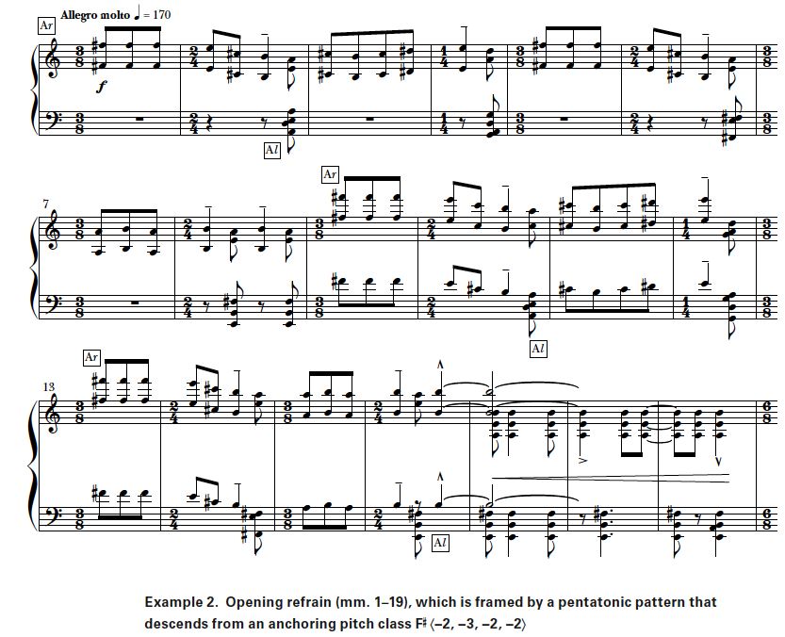

Slide 27
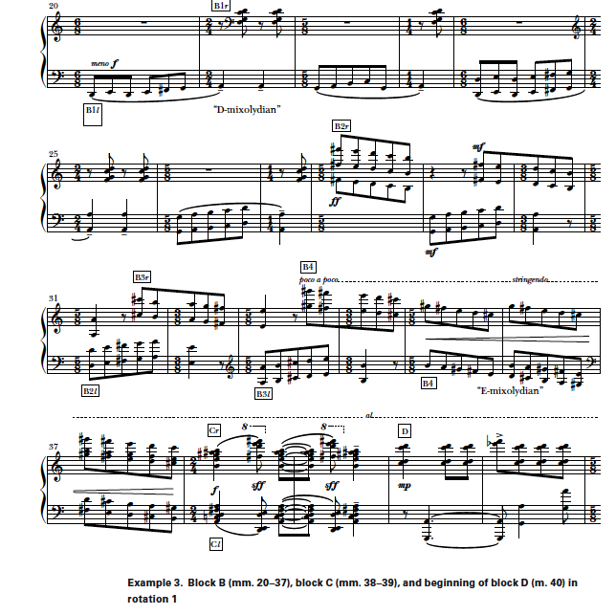
Blocks B transitional: short scale segments overlap and modulate through different diatonic regions.
Passage in rotation 1 (mm. 20–38) builds up a forward-driving counterpoint of partially overlapping diatonic scale segments, culminating in polychords at m. 38.

Slide 28
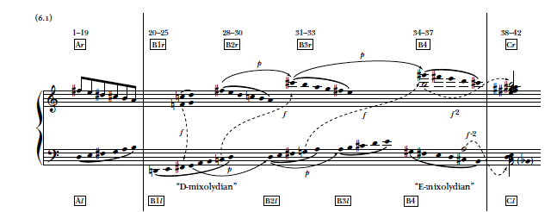
“modulation” from “D-Mixolydian” region (B1l ) toward “E-Mixolydian” region (B4), accomplished through upward transposition by P5 of certain scale segments on both hands

Slide 29
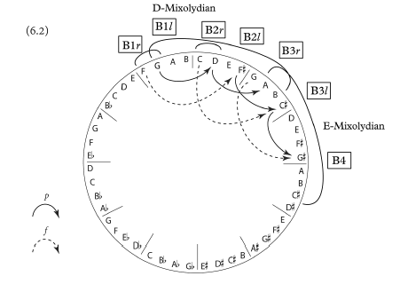
B1l and B4 symmetrical, overlapping space elements (A, 1) & (B, 2)
succession of segments shifts clockwise
rh F♯–C♯–G♯, lh G–D–A modeled by transpositio (p),
(F♯, 3) → (C♯, 3) → (G♯, 3), and (p), (G, 1) → (D, 1) → (A, 1)
chromatic mismatches modeled by transformatio (f ),
(F, 0) → (F♯, 3), (C, 0) → (C♯, 3), and (G, 0) → (G♯, 3)

Slide 30
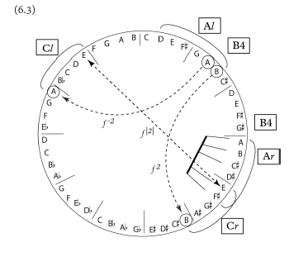

Slide 34
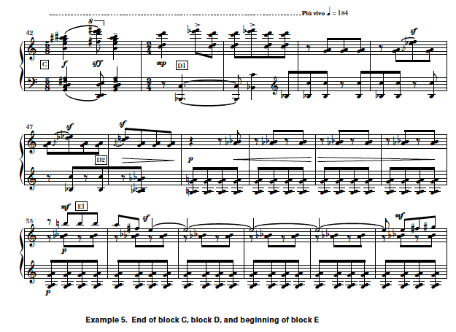

Slide 35
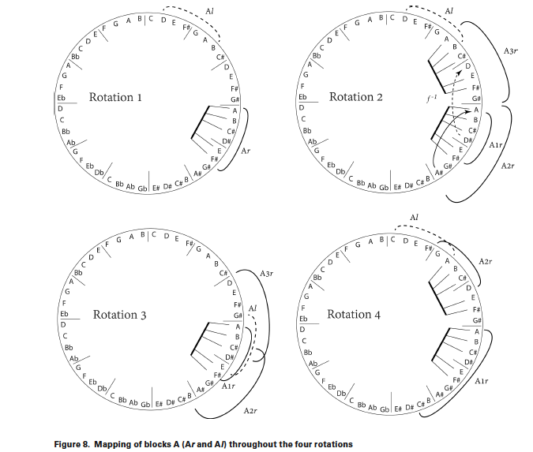

Slide 36
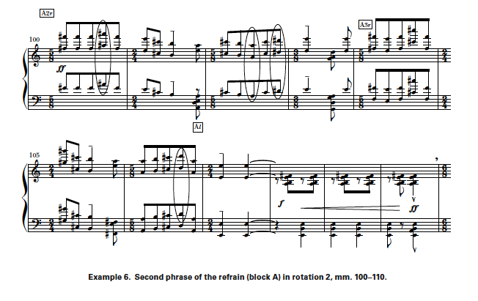

Slide 37
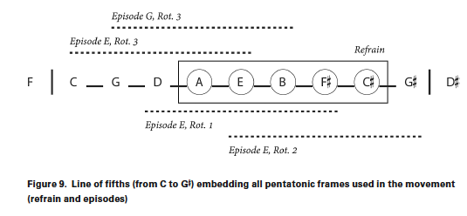

Slide 38
